Slide 1
Party Ideas
Prepare
Store
Serve
Parth Chandgadhiya [300986134],party planner

Slide 2
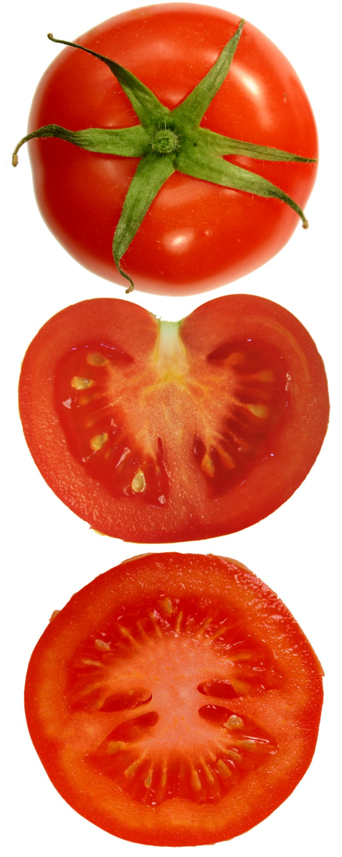
Appetizers
Name | Level
Filled Cherry Tomatoes | Beginner
Small Spinach Pies | Intermediate
Chicken Kabobs | Beginner
Salmon Pockets | Advanced
This Photo by Unknown Author is licensed under CC BY-SA

Slide 3
A party to remember!

